Slide 1
Multiple Inheritance

Slide 2
Outline
Multiple Inheritance in Java
The Diamond Problem
Interfaces

Slide 3



Multiple Inheritance
Multiple Inheritance is a feature in object orient programming where a child class can inherit properties of more than one parent class.

Slide 4
Multiple Inheritance
Unlike other popular object-oriented programming languages such as C++, java does not provide support for multiple inheritance for classes.

Slide 5
interface
Father
{
}
interface
Mother
{
}
public class
Daughter implements Father, Mother
{
}

Slide 6
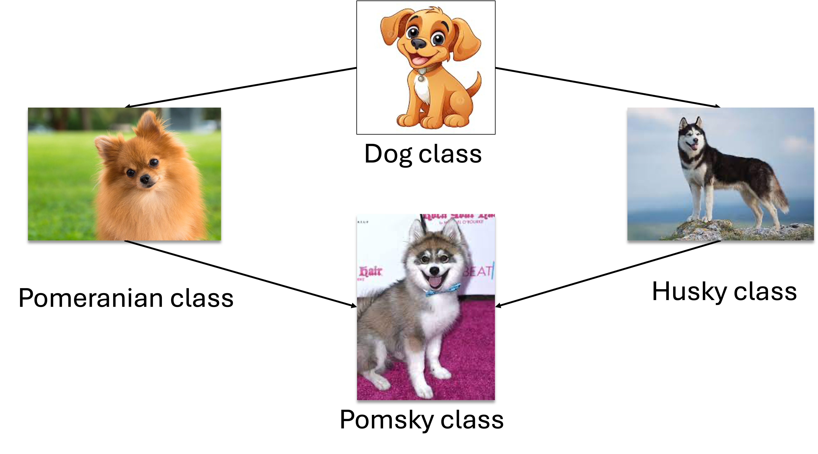
The Diamond Problem
Java does not support multiple inheritance in classes because it can lead to the diamond problem.

Slide 7
The Diamond Problem
The diamond problem is a situation where the compiler does not know exactly which class method to execute if that class method is defined in the parent class and its child classes.

Slide 8




Dog class
Pomeranian class
Husky class
Pomsky class

Slide 9
class Dog
bark()
class Pomeranian
bark()
class Husky
bark()
The bark() method is ambiguous because java does not know which bark() method to execute.
class Pomsky

Slide 10
public class
Dog
{
public void bark();
}
public class
{
Pomeranian extends Dog
public void bark() {“Pomeranian is barking“;}
}
public class
Husky extends Dog
{
public void bark() {“Husky is barking“;}
}

Slide 11
public class
Pomsky extends Pomeranian, Husky
{
}
{
public class App
public static void
main
(String[] args)
{
Pomsky mypomsky = new Pomsky();
mypomsky.bark();
Which bark() method are you referring to ???
}
}

Slide 12
public class
Pomsky extends Pomeranian, Husky
{
}
{
public class App
public static void
main
(String[] args)
{
Pomsky mypomsky = new Pomsky();
mypomsky.bark();
Java does not support multiple inheritance in classes to avoid all the complexity
and to keep things simple and straightforward.
}
}

Slide 13

class Dog
bark()
class Pomeranian
bark()
class Husky
bark()
class Pomsky

Slide 14
Outline
Multiple Inheritance in Java
The Diamond Problem
Interfaces

Slide 15
Interface
Multiple Inheritance is supported in java through interfaces.
There will be no ambiguity because interfaces only declare methods and the actual implementation will be done by concrete classes implementing the interfaces.

Slide 16
Interface
A single interface can extend multiple interfaces.
A single class can implement multiple interfaces.

Slide 17
interface Dog
bark()
interface Pomeranian
height=15inches
play()
interface Husky
eyeColor=blue
dig()
class Pomsky
Concrete class

Slide 18

Dog.java
interface Dog
bark()
interface Dog {
void bark();
}
Pomeranian.java
interface Pomeranian
height=15inches
play()
interface Husky
eyeColor=blue
dig()
interface Pomeranian extends Dog {
String height = "15 inches";
void play();
}
Husky.java
interface Husky extends Dog {
String eyeColor = "blue";
void dig();
}

Slide 19
Dog.java
interface Dog {
void bark();
}
Pomeranian.java
interface Pomeranian extends Dog {
String height = "15 inches";
void play();
}
Interface methods do not have a body. The body is provided by the "implement" class.
Husky.java
interface Husky extends Dog {
String eyeColor = "blue";
void dig();
}

Slide 20
Pomsky.java
interface Dog
bark()
class Pomsky implements Husky, Pomeranian {
@Override
public void bark() {
System.out.println("Woof! Woof!");
}
@Override
public void play() {
System.out.println("Pomsky is playing!");
}
@Override
public void dig() {
System.out.println("Pomsky is digging!");
}
}
interface Pomeranian
height=15inches
play()
interface Husky
eyeColor=blue
dig()
class Pomsky

Slide 21
Pomsky.java
class Pomsky implements Husky, Pomeranian {
@Override
public void bark() {
System.out.println("Woof! Woof!");
}
@Override
public void play() {
System.out.println("Pomsky is playing!");
}
@Override
public void dig() {
System.out.println("Pomsky is digging!");
}
}
To access the interface methods, the interface must be "implemented" by another class with the implements keyword.

Slide 22
Pomsky.java
class Pomsky implements Husky, Pomeranian {
@Override
public void bark() {
System.out.println("Woof! Woof!");
}
@Override
public void play() {
System.out.println("Pomsky is playing!");
}
@Override
public void dig() {
System.out.println("Pomsky is digging!");
}
}
The body of the interface method is provided by the implementing class.

Slide 23
Pomsky.java
class Pomsky implements Husky, Pomeranian {
@Override
public void bark() {
System.out.println("Woof! Woof!");
}
@Override
public void play() {
System.out.println("Pomsky is playing!");
}
@Override
public void dig() {
System.out.println("Pomsky is digging!");
}
}
You must override all methods when implementing interfaces. The @Override annotation is used to indicate that a method is overridden.

Slide 24
App.java
public class App {
public static void main(String[] args) throws Exception {
Pomsky myPomsky = new Pomsky();
myPomsky.bark(); // Output: Woof! Woof!
myPomsky.play(); // Output: Pomsky is playing!
myPomsky.dig(); // Output: Pomsky is digging!
System.out.println("My pomsky has " + myPomsky.eyeColor + " eyes.");
System.out.println("My pomsky is " + myPomsky.height + " tall.");
}
}
Interfaces cannot be used to create objects
This is why an implementing class is needed

Slide 25
Pomeranian.java
interface Pomeranian {
String height = "15 inches";
void bark();
}
interface Pomeranian
height=15inches
bark()
interface Husky
eyeColor=blue
Husky.java
class Husky extends Dog {
String eyeColor = "blue";
}
Pomsky.java
class Pomsky
bark()
class Pomsky extends Husky implements Pomeranian {
@Override
public void bark() {
System.out.println("My pomsky is barking");
}
}

Slide 26
Pomeranian.java
interface Pomeranian {
String height = "15 inches";
void bark();
}
Husky.java
It is possible to use both extend and implement.
In this example, the Pomsky class extends the Husky class and implements the Pomeranian interface at the same time
class Husky extends Dog {
String eyeColor = "blue";
}
Pomsky.java
class Pomsky extends Husky implements Pomeranian {
@Override
public void bark() {
System.out.println("My pomsky is barking");
}
}

Slide 27
Summary
Interfaces cannot be used to create objects.
Interface methods do not have a body - the body is provided by the "implement" class.
When implementating an interface, you must override all of its methods.
Interface methods are by default abstract and public.
Interface attributes are by default public, static and final.
An interface cannot contain a constructor.

Slide 28
Summary
Why And When To Use Interfaces?
To achieve security - hide certain details and only show the important details of an object (interface).
Java does not support "multiple inheritance. However, it can be achieved with interfaces, because the class can implement multiple interfaces.

